Slide 1

BRISBANE BOYS’ COLLEGE
IMMC

Slide 2
Maximum Population
Maslow’s Human Hierarchy of Needs
Physiological Needs
Tangible
Intangible
Safety Needs
Love and belonging
Esteem
Self-actualization
Warmth
Water
Food
Shelter
Sex
Sleep
Land
Water
Factors
Resources

Slide 3
1st Model
(Current Conditions)
Removal of Waste
Unused Resources
Trends
Ratios
2nd Model
(Future/ Perceived)
Ratios - Optimised

Slide 4
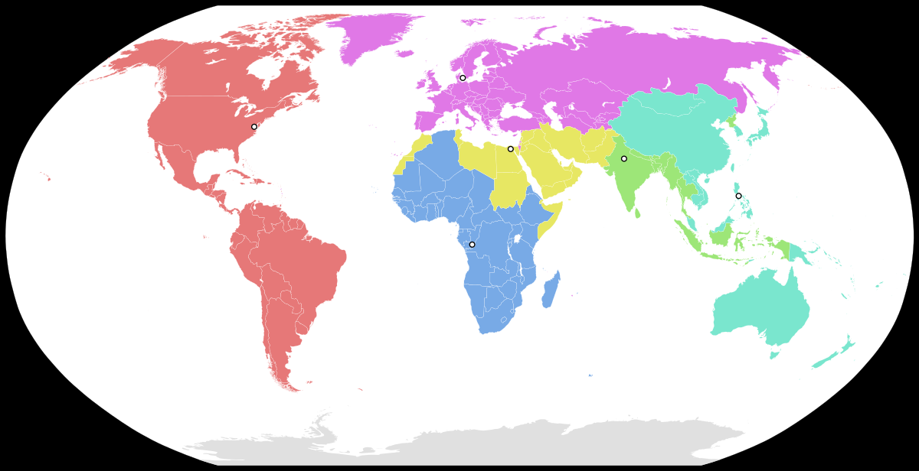
REGION
Africa
Brazil
Canada
China
Europe (exc. Russia)
Greenland
India
Latin America and the carribean (exc. Brazil)
Middle East
Oceania
Rest of Asia (exc. India and China)
Russia
US

Slide 5
Total Available Resources
 | Total Available Resources
REGION | Water (kmÂ³ per year) | Land (million hectares)
Africa | 1572.40 | 1485.82
Brazil | 2264.25 | 834.82
Canada | 1303.68 | 814.80
China | 1124.98 | 555.50
Europe (exc. Russia) | 2630.40 | 765.64
Greenland | 241.20 | 178.48
India | 578.46 | 223.43
Latin America and the carribean (exc. Brazil) | 3119.35 | 1046.68
Middle East | 193.60 | 246.69
Oceania | 360.80 | 541.59
Rest of Asia (exc. India and China) | 531.36 | 1836.81
Russia | 2511.20 | 778.60
US | 1127.12 | 576.00
WORLD | 17558.8 | 9884.860981

Slide 6
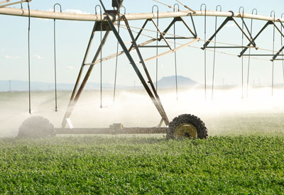

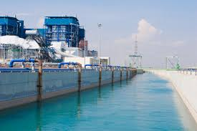
Water
Municipal Water
Agricultural Water
Industrial Water

Slide 7
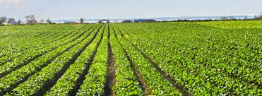
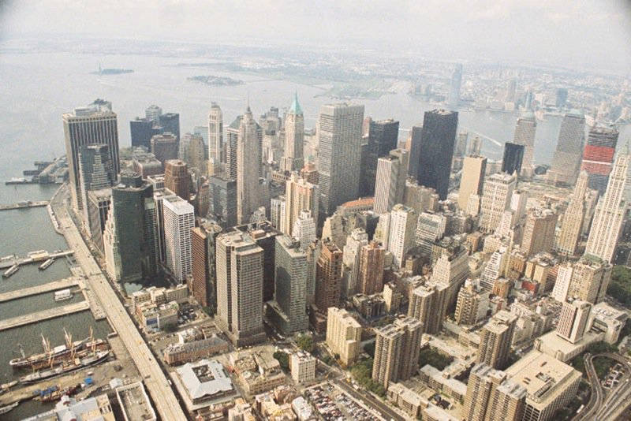
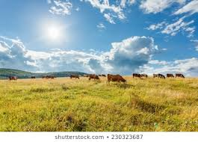
Land
Crop Land
Urban Land
Grazing Land

Slide 8
Percentage of Total Water/Land
Water/Land per Category
REGIONS | Useage
 | Water (kmÂ³ per year) |  |  |  | Land (million hectares)
 | Agricultural |  | Industrial | Municipal | Agricultural |  | Urban
 | Grazing | Crops |  |  | Grazing | Crops
Africa | 429.0577759 | 859.4040137 | 83.79477817 | 200.1434322 | 1132.411656 | 348.4812327 | 4.92338575
Brazil | 452.720676 | 906.8008736 | 385.1473076 | 519.5855187 | 585.3539869 | 237.7573286 | 11.71229094
Canada | 53.13559846 | 106.4307633 | 1112.831733 | 31.2815925 | 179.7463993 | 624.7384687 | 10.31261511
China | 242.8519691 | 486.4332233 | 252.7507092 | 142.9414123 | 439.4513492 | 107.3341273 | 8.715927279
Europe (exc. Russia) | 277.9795069 | 556.7937871 | 1239.648267 | 555.9784387 | 249.5421988 | 479.5113332 | 36.58840368
Greenland | 0 | 0 | 0 | 0 | 0 | 0 | 0
India | 166.121323 | 332.7415088 | 15.18744295 | 64.41262567 | 12.61646515 | 207.0056753 | 3.809798573
Latin America and the Carribean (exc. Brazil) | 786.1940125 | 1574.748968 | 326.7333418 | 431.6693018 | 796.9219808 | 238.0068235 | 11.75377979
Middle East | 56.37349815 | 112.9162861 | 13.12176272 | 11.18845304 | 206.9557886 | 36.17831276 | 3.559230139
Oceania | 74.15042995 | 148.5235339 | 66.39697656 | 71.72905963 | 474.0979786 | 66.07348735 | 1.423152851
Rest of Asia (exc. India and China) | 151.8193579 | 304.0946297 | 46.08384194 | 29.3619561 | 1108.858133 | 708.9457619 | 19.00348411
Russia | 180.954602 | 362.4526111 | 1630.221639 | 337.5711475 | 340.4397465 | 429.2018025 | 8.957113266
US | 137.3181557 | 275.0486783 | 584.9909855 | 129.7624932 | 342.0347359 | 217.6499204 | 16.31124516
WORLD | 3008.676906 | 6026.388877 | 5756.908786 | 2525.625431 | 5868.430419 | 3700.884274 | 137.0704266
Total Water/Land

Slide 9
Water Consumption Rates
Population Influenced by Municipal Water
Total Municipal Water
REGIONS | Municipal Water
 | Consumption Rate | Population
Africa | 43405473.52 | 8687320447
Brazil | 12196969.7 | 6337368827
Canada | 39806659.51 | 1245215701
China | 18357615.89 | 2624063543
Europe (exc. Russia) | 9080661.037 | 5048651746
Greenland | 0 | 0
India | 18571428.57 | 1196234477
Latin America and the carribean (exc. Brazil) | 12588894.6 | 5434239342
Middle East | 28439363.95 | 318192488
Oceania | 8702474.892 | 624220340
Rest of Asia (exc. India and China) | 32075152.68 | 941789225
Russia | 17621951.22 | 5948662295
US | 5938294.011 | 770567836
WORLD | 246784939.6 | 3.9177E+10

Slide 10
Resources
Land
Shelter
Food Production
Water
Food Production
Municipal Water

Slide 11
Food Production - Water
REGION | Water (kmÂ³ per million hectares) |  | Land due to Water |  | Land available |  | Limiting
 | Grazing | Crops | Grazing | Crops | Grazing | Crops | Grazing | Crops
Africa | 0.067544307 | 0.219489469 | 6352.241867 | 3915.468096 | 1132.411656 | 348.4812327 | Land | Land
Brazil | 0.076289399 | 0.187823039 | 5934.254034 | 4827.953359 | 585.3539869 | 237.7573286 | Land | Land
Canada | 0.108316159 | 0.031164144 | 490.5602183 | 3415.167245 | 179.7463993 | 624.7384687 | Land | Land
China | 0.3024283 | 1.238213117 | 803.00676 | 392.8509693 | 439.4513492 | 107.3341273 | Land | Land
Europe (exc. Russia) | 0.329224398 | 0.171331467 | 844.346617 | 3249.804582 | 249.5421988 | 479.5113332 | Land | Land
Greenland | 0 | 0 | 0 | 0 | 0 | 0 | Unknown | Unknown
India | 18.05254783 | 1.100256504 | 9.202098483 | 302.4217605 | 12.61646515 | 207.0056753 | Water | Land
Latin America and the carribean (exc. Brazil) | 0.17748426 | 0.594273331 | 4429.654852 | 2649.873189 | 796.9219808 | 238.0068235 | Land | Land
Middle East | 0.361688571 | 2.069016978 | 155.8619838 | 54.57484751 | 206.9557886 | 36.17831276 | Water | Land
Oceania | 0.013193881 | 0.094670229 | 5620.062191 | 1568.851538 | 474.0979786 | 66.07348735 | Land | Land
Rest of Asia (exc. India and China) | 0.834137005 | 1.304669062 | 182.0077001 | 233.0818126 | 1108.858133 | 708.9457619 | Water | Water
Russia | 0.044509493 | 0.035304606 | 4065.528235 | 10266.4397 | 340.4397465 | 429.2018025 | Land | Land
US | 0.232307038 | 0.365068254 | 591.1063079 | 753.4171351 | 342.0347359 | 217.6499204 | Land | Land
WORLD | 20.59967064 | 7.411280201 | 29477.83287 | 31629.90423 | 5868.430419 | 3700.884274 | Land | Land

Slide 12
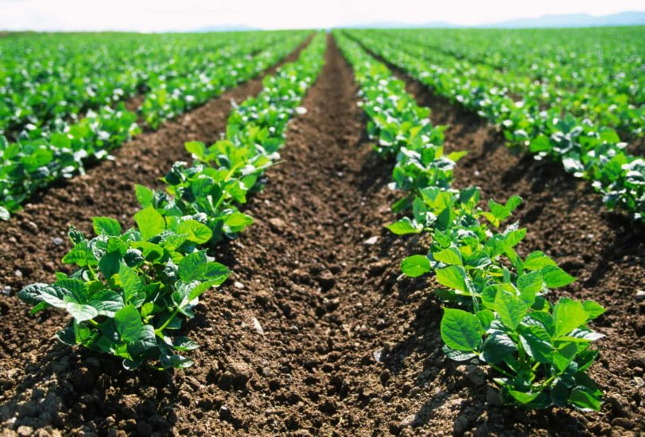
Food Production per area of land
Land (million hectares)
Agricultural
Grazing | Crops
1132 | 348
585 | 238
180 | 625
439 | 107
250 | 480
0 | 0
13 | 207
797 | 238
207 | 36
474 | 66
1109 | 709
340 | 429
342 | 218
5868 | 3701
Produces (tonnes)
Grazing | Crops
9E+07 | 9.5E+08
2E+08 | 7.9E+08
2E+08 | 1.2E+09
2E+08 | 1.7E+09
6E+08 | 1.8E+09
0 | 0
2E+08 | 7.6E+08
2E+08 | 8.7E+08
4E+07 | 2E+08
5E+07 | 8.4E+07
8E+07 | 1.3E+09
1E+08 | 6.4E+08
2E+08 | 9.5E+08
2E+09 | 1.1E+10
Production
Land (tonnes per million hectares)
Grazing | Crops
79043 | 2720222
323159 | 3308695
898104 | 1842995
378181 | 16088329
2560227 | 3717701
0 | 0
17193277 | 3659125
210897 | 3661666
230209 | 5540031
108050 | 1265194
438824 | 5407757
436381 | 1502086
585875 | 4350696
23442227 | 53064497
REGION
Africa
Brazil
Canada
China
Europe (exc. Russia)
Greenland
India
Latin America and the Caribbean (exc. Brazil)
Middle East
Oceania
Rest of Asia (exc. India and China)
Russia
US
WORLD
REGION
Africa
Brazil
Canada
China
Europe (exc. Russia)
Greenland
India
Latin America and the Caribbean (exc. Brazil)
Middle East
Oceania
Rest of Asia (exc. India and China)
Russia
US
WORLD

Slide 13

Imports and Exports
Ratio
Export (% of produce) |  | Import (% of world export)
Grazing | Crops | Grazing | Crops
0.009 | 0.027 | 0.058 | 0.126
0.110 | 0.355 | 0.004 | 0.017
0.144 | 0.583 | 0.012 | 0.012
0.011 | 0.012 | 0.107 | 0.166
0.186 | 0.350 | 0.505 | 0.299
0.000 | 0.000 | 0.000 | 0.000
0.008 | 0.047 | 0.000 | 0.012
0.039 | 0.359 | 0.074 | 0.094
0.043 | 0.098 | 0.079 | 0.104
0.179 | 0.494 | 0.011 | 0.007
0.015 | 0.079 | 0.144 | 0.206
0.008 | 0.210 | 0.027 | 0.013
0.059 | 0.255 | 0.031 | 0.048

Slide 14
Imports and Exports
Food Produced
IMPORTS
EXPORTS

Slide 15
Consumption Rate (tonnes per person)
Resulting Food (tonnes)

Slide 16
Population based on FOOD
Population
Grazing | Crops | Maximum
1.64E+09 | 1.8E+09 | 1.64E+09
6.25E+08 | 6.22E+08 | 6.22E+08
4.29E+08 | 3.82E+08 | 3.82E+08
1.54E+09 | 1.64E+09 | 1.54E+09
1.5E+09 | 1.56E+09 | 1.5E+09
0 | 0 | 0
1.2E+09 | 1.68E+09 | 1.2E+09
9.9E+08 | 1.05E+09 | 9.9E+08
4.07E+08 | 6.75E+08 | 4.07E+08
53874106 | 62419001 | 53874106
1.18E+09 | 2.3E+09 | 1.18E+09
4.92E+08 | 4.91E+08 | 4.91E+08
4.53E+08 | 4.82E+08 | 4.53E+08
1.05E+10 | 1.27E+10 | 1.05E+10
Region
Africa
Brazil
Canada
China
Europe (exc. Russia)
Greenland
India
Latin America and the carribean (exc. Brazil)
Middle East
Oceania
Rest of Asia (exc. India and China)
Russia
US
WORLD

Slide 17
SHELTER
Urban Land
Urban Population
Urban Population Density

Slide 18
SHELTER
Rural Land
Rural Population
Rural Population Density

Slide 19
Urban Population
Rural Population

Slide 20
Population due to shelter
REGION
Africa
Brazil
Canada
China
Europe (exc. Russia)
Greenland
India
Latin America and the Caribbean (exc. Brazil)
Middle East
Oceania
Rest of Asia (exc. India and China)
Russia
US
WORLD
Population
1.5E+09
6.3E+08
4.6E+08
1.4E+09
1.5E+09
0.0E+00
1.6E+09
9.8E+08
4.2E+08
5.3E+07
5.7E+09
5.0E+08
4.5E+08
1.5E+10

Slide 21
Final Population
REGION
Africa
Brazil
Canada
China
Europe (exc. Russia)
Greenland
India
Latin America and the carribean (exc. Brazil)
Middle East
Oceania
Rest of Asia (exc. India and China)
Russia
US
WORLD
Population
1.5E+09
6.2E+08
3.8E+08
1.4E+09
1.5E+09
0.0E+00
1.2E+09
9.8E+08
3.2E+08
5.3E+07
9.4E+08
4.9E+08
4.5E+08
9.9E+09
Limiting Factor
Shelter
Food
Food
Shelter
Shelter
N/A
Water
Shelter
Water
Shelter
Water
Food
Shelter

Slide 22
INDIA
 | Grazing | Crops | Urban | Municipal | Industrial
Land Ratio | 5.6% | 92.7% | 1.7% | - | -
Water Ratio | 28.7% | 57.5% | - | 11.2% | 2.6%
Possible Population | 1.2 billion (limited by Water) | 1.68 billion (limited by Land) | 1.64 billion | 1.2 billion | -
Model 1

Slide 23
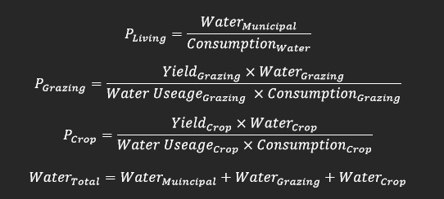
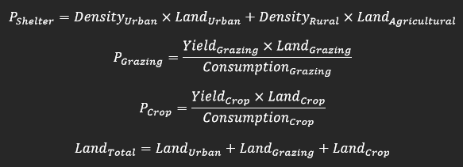
Population
Municipal
Grazing
Crops
Shelter
Grazing
Crops

Slide 24
 | Grazing | Crops | Urban | Municipal | Industrial
Land Ratio | 5.6% | 92.7% | 1.7% | - | -
Water Ratio | 28.7% | 57.5% | - | 11.2% | 2.6%
Possible Population | 1.2 billion (limited by Water) | 1.68 billion (limited by Land) | 1.64 billion | 1.2 billion | -
Land Ratio | 3.9% | 91.2% | 4.9% | - | -
Water Ratio | 30.4% | 44.6% | - | 22.4% | 2.6%
Possible Population | 2.48 billion (limited by Land) | 2.48 billion (limited by Land) | 2.48 billion | 2.81 billion | -
Model 1
Model 2

Slide 25
BRISBANE BOYS’ COLLEGE
IMMC

